Slide 1
Lower Bounds
CS240 Spring 2021
Rui Fan

Slide 2
Upper and lower bounds
What is the minimum resources (time, space, etc.) needed to solve a problem?
Consider sorting n numbers.
Insertion sort takes O(n²) time.
This puts an upper bound of O(n²) on the time to sort n numbers.
Merge sort takes O(n log n) time.
This puts an upper bound of O(n log n) on the time to sort n numbers.
We want to make the upper bound as low as possible, i.e. solve the problem faster.
Suppose an algorithm A solves problem X in f(n) time when input size is n.
Then f(n) is an upper bound on the complexity of X.

Slide 3
Upper and lower bounds
What about the least amount of time to solve X?
Suppose we know that any algorithm that solves X takes at least g(n) time, when X has size n.
Then g(n) is a lower bound on the complexity of X.
If the lower bound g(n) is large, it means problem X is hard to solve.
Ex NP-Hard problems are hard because they (probably) have super-polynomial lower bounds.
To show a lower bound, we need to give a proof.
Usually we show if an algorithm takes too little time, it must sometimes produce the wrong answer.
The lower bound for a problem depends on the computational model.
If a model has very powerful primitive operations, then algorithms can run faster, and the lower bound is smaller.
If the complexity of an algorithm for problem X matches the lower bound for problem X, the algorithm is optimal, and the lower bound is tight.

Slide 4
A warm-up
Say we want to find the larger of two numbers x and y.
We can do this with 1 comparison, so this is an upper bound.
What’s the lower bound? Do we need at least 1 comparison? Can we do 0 comparisons?
No. Suppose an algorithm doesn’t compare x and y.
So basically, the algorithm declares either x or y to be bigger, without looking at them.
Say the algorithm declares x bigger. Then let’s set y > x.
Algorithm won’t notice this, cause it doesn’t compare x and y.
So algorithm still declares x is bigger, which is wrong.
This type of argument is called indistinguishability, and is frequently used when proving lower bounds.
Same argument if algorithm always declares y bigger without comparing.
Hence, any algorithm must do at least 1 comparison, so 1 is a lower bound.

Slide 5
Outline
We’ll prove lower bounds for the following problems.
Merging two lists.
Finding the max.
Finding the max and min.
Sorting n numbers.

Slide 6
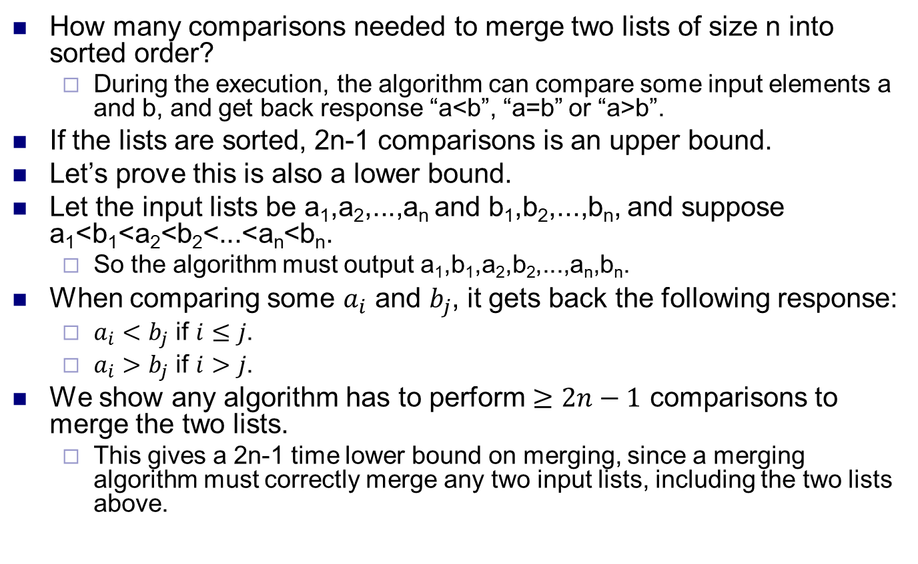
Merging two lists
How many comparisons needed to merge two lists of size n into sorted order?
During the execution, the algorithm can compare some input elements a and b, and get back response “a<b”, “a=b” or “a>b”.
If the lists are sorted, 2n-1 comparisons is an upper bound.
Let’s prove this is also a lower bound.
Let the input lists be a₁,a₂,...,a_{n} and b₁,b₂,...,b_{n}, and suppose a₁<b₁<a₂<b₂<...<a_{n}<b_{n}.
So the algorithm must output a₁,b₁,a₂,b₂,...,a_{n},b_{n}.
When comparing some $a_{i}$ and $b_{j}$, it gets back the following response:
$a_{i}<b_{j}$ if $i≤j$.
$a_{i}>b_{j}$ if $i>j$.
We show any algorithm has to perform $≥2n−1$ comparisons to merge the two lists.
This gives a 2n-1 time lower bound on merging, since a merging algorithm must correctly merge any two input lists, including the two lists above.

Slide 7
Merging two lists
Claim Any correct algorithm must compare a_{i} to b_{i}, for every i.
Suppose not; say the algorithm doesn’t compare a₁ to b₁.
Now, if the input was actually b₁<a₁<a₂<b₂<...<a_{n}<b_{n}, then the algorithm still outputs a₁,b₁,...,a_{n},b_{n}, which is wrong.
Because the algorithm doesn’t compare a₁ and b₁, it can’t distinguish the new input from the original.
Same argument if algorithm doesn’t compare a_{i} to b_{i}, for any i.
So algorithm does n comparisons of this type.
Claim Any correct algorithm must compare b_{i} to a_{i+1}, for every i<n.
If not, then say it doesn’t compare b₁ to a₂. Then it can’t distinguish original input from input a₁<a₂<b₁<b₂<...<a_{n}<b_{n}, and will give wrong answer.
Thus, n-1 comparisons of this type.
So, any algorithm must do at least 2n-1 comparisons.
So 2n-1 is a lower bound on the complexity to merge into sorted order.

Slide 8
Finding the max
How many comparisons to find the largest number in an unsorted array of n distinct numbers.
Upper bound: n-1.
Lower bound: also n-1.
To prove this, we’ll keep track of what information the algorithm learns at it executes.
Say algorithm never compared some element to any other element.
Then the algorithm doesn’t know anything about this element. It could be the max, or not the max.
Thus, the algorithm can’t correctly output the max without comparing this element to some others.
Say there are two elements, and both are larger than every element they’ve been compared to.
Then either one of them could be the max.
So algorithm can’t output the max without comparing these two elts.
Let’s formalize this intuition.

Slide 9
Finding the max
At any stage of the alg, give every array element one of 3 colors, white, blue or red.
White means this element has never been compared to any other element.
Blue means this element is bigger than all the elements it’s been compared to.
Red means this element was smaller than some element it was compared to.
Let w_{k}, b_{k}, r_{k} be number of white, blue and red elements after A has done k comparisons.
So initially, w₀=n and b₀=r₀=0.
We’ll show that for any k, w_{k}+b_{k} ≥ n-k.
We’ll show that as long as w_{k}+b_{k} > 1, A can’t terminate.
Hence, when A terminates, we have w_{k}+b_{k} = 1, and A must have done k ≥ n-1 comparisons.

Slide 10
Finding the max
Claim For any k, w_{k}+b_{k} ≥ n-k.
Proof By induction on k. Claim holds for k=0.
For larger k, consider the k’th comparison. It must either be between: 2 white elements (WW case), a white and blue element (WB case), a white and red (WR), 2 reds (RR), 2 blues (BB), red and blue (RB).
Do a case by case analysis.
WW: Make the first element > second element.
This is possible, because both elements are white, so neither have been in any comparisons, so they can be in either order.
After comparison, first element becomes blue, second element red.
Number of whites decreases by 2, blues increases by 1.
By induction, w_{k-1}+b_{k-1} ≥ n-k+1. Also, w_{k}=w_{k-1}-2, and b_{k}=b_{k-1}+1. So w_{k}+b_{k} ≥ n-k.
WB: Make the first element < second element.
This is possible, since first element hasn’t been in any comparisons.
So first element becomes red, second remains blue.
So w_{k}=w_{k-1}-1, b_{k}=b_{k-1}, so w_{k}+b_{k} ≥ n-k.

Slide 11
Finding the max
WR: Make the first element > second element. First element becomes blue, second stays red.
So w_{k}=w_{k-1}-1, b_{k}=b_{k-1}+1, so w_{k}+b_{k} ≥ n-k+1 > n-k.
RR: Make first element > second element. Both elements stay red.
w_{k}+b_{k} = w_{k-1}+b_{k-1} ≥ n-k+1 > n-k.
BB: Make first element > second element. First one stays blue, second becomes red.
w_{k}+b_{k} = w_{k-1}+b_{k-1}-1 ≥ n-k.
RB: Make first element < second element. Both elements stay same color.
w_{k}+b_{k} = w_{k-1}+b_{k-1} ≥ n-k+1 > n-k.
Hence w_{k}+b_{k} ≥ n-k by induction.

Slide 12
Finding the max
Claim Suppose after making k comparisons, we have w_{k}+b_{k}>1. Then A cannot terminate.
Proof Say A terminates, and outputs a value x as the max.
Since w_{k}+b_{k}>1, either w_{k}≥1, or b_{k}>1.
If w_{k}≥1, then there’s a white element y that’s never been compared to x (or any other elt).
Make y > x. Then the algorithm is wrong.
If b_{k}>1, then there are at least 2 blue elements.
x must be a blue element.
If x is red, it’s not max.
x is not white, by above.
Take another blue element z. x and z were never compared.
If they had been, either x or z would have turned red.
Make z > x. Now A is wrong.
Since A can’t terminate as long as w_{k}+b_{k}>1, then k ≥ n-1 when A terminates.
So A does ≥ n-1 comparisons.

Slide 13
Finding the max and min
How many comparisons does it take to find the max and min elements in an unsorted array A of n distinct numbers.
Upper bound 1: 2n-2 comparisons.
Upper bound 2: 3n/2-2 comparisons.
Pair up the elements, A[1] and A[2], A[3] and A[4], etc.
Compare the elements in each pair (n/2 comps total).
Put all the bigger elements in a temp array Big, put all the smaller elements in temp array Small.
Big and Small each have size n/2.
Find the max element in Big and output it as max of A (n/2-1 comparisons).
Find the min element in Small and output it as the min of A (n/2-1 comparisons).
Upper bound 3: 3n/2-2 comparisons via divide and conquer.
Exercise.
Lower bound: 3n/2-2 comparisons!

Slide 14
Finding the max and min
Intuition for proof is similar to one for max.
At any stage of alg, give each array element one of 4 colors, white, blue, red and purple, representing what the algorithm knows about the element.
White means this element has never been compared against any other element.
Blue means this element is bigger than all the elements it’s been compared against.
Red means this element was smaller than every element it was compared against.
Purple means this element was bigger than some elt(s) it was compared to, and smaller than some other(s).

Slide 15
Finding the max and min
To terminate, algorithm must eliminate all white elements, since these could be the min or max.
Also, algorithm can only leave one blue and one red.
Else either of two blues can be max, either of two reds can be min.
As comparisons happen, algorithm gets more info, and elements change color, e.g. from white to blue, red to purple, etc.
Too few comparisons means the algorithm doesn’t have time to eliminate all whites, and all but 1 blue and red.
Proof keeps track of number of whites, blues and reds after some number of comparisons.

Slide 16
Finding the max and min
Label each comparison by its type.
E.g. WW is comparison between two white elts.
There are 10 types, WW, WB, WR, WP, BB, BR, BP, RR, RP, PP.
Denote the number of comparisons of type WW by ww, number of WB comps by wb, etc. 10 numbers total.
Let w, b, r denote number of whites, blues and reds, resp., at some stage of the algorithm.

Slide 17
Finding the max and min
Claim 1 When A terminates, w=0 and b=r=1.
Proof Say A outputs x as max, y as min.
Neither x nor y can be white, since we can make a white element be neither max nor min.
If there is a white element z when A terminates, we can make z > x, and A is wrong. So w=0.
x must be a blue element, as in the finding max proof.
If there’s another blue element z, then x and z weren’t compared, so we can make z > x, and A is wrong. So b=1.
y must be a red element.
If there’s another red element z, then we can make z < y, and A is wrong. So r=1.

Slide 18
Finding the max and min
The table states what happens when each type of comparison occurs. Similar to the case analysis in finding max proof.
Ex If WW occurs, make the first element > second element (denoted E₁>E₂), so these elements become blue and red (BR).
Ex If WB occurs, we make the first element < second element (denoted E₁<E₂), so the elements become red and blue (RB).
Comparison type | Result | Comparison type | Result
WW | E₁>E₂, BR | BR | E₁>E₂, BR
WB | E₁<E₂, RB | BP | E₁>E₂, BP
WR | E₁>E₂, BR | RR | E₁<E₂, RP
WP | E₁>E₂, BP | RP | E₁<E₂, RP
BB | E₁>E₂, BP | PP | E₁<E₂, PP

Slide 19
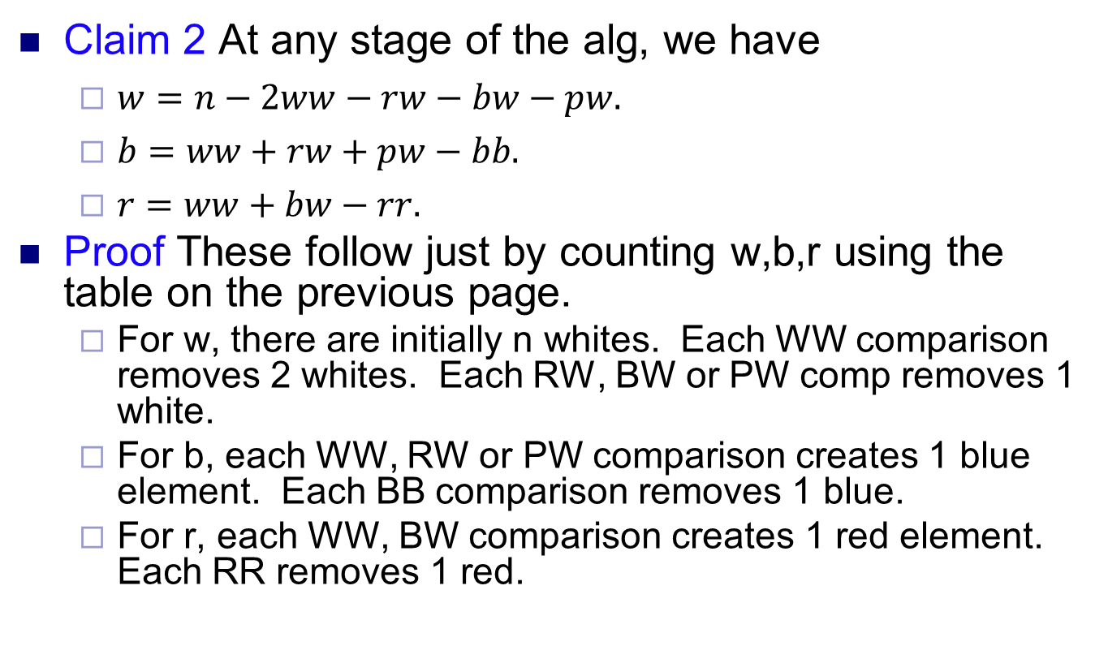
Finding the max and min
Claim 2 At any stage of the alg, we have
$w=n−2ww−rw−bw−pw.$
$b=ww+rw+pw−bb.$
$r=ww+bw−rr.$
Proof These follow just by counting w,b,r using the table on the previous page.
For w, there are initially n whites. Each WW comparison removes 2 whites. Each RW, BW or PW comp removes 1 white.
For b, each WW, RW or PW comparison creates 1 blue element. Each BB comparison removes 1 blue.
For r, each WW, BW comparison creates 1 red element. Each RR removes 1 red.

Slide 20
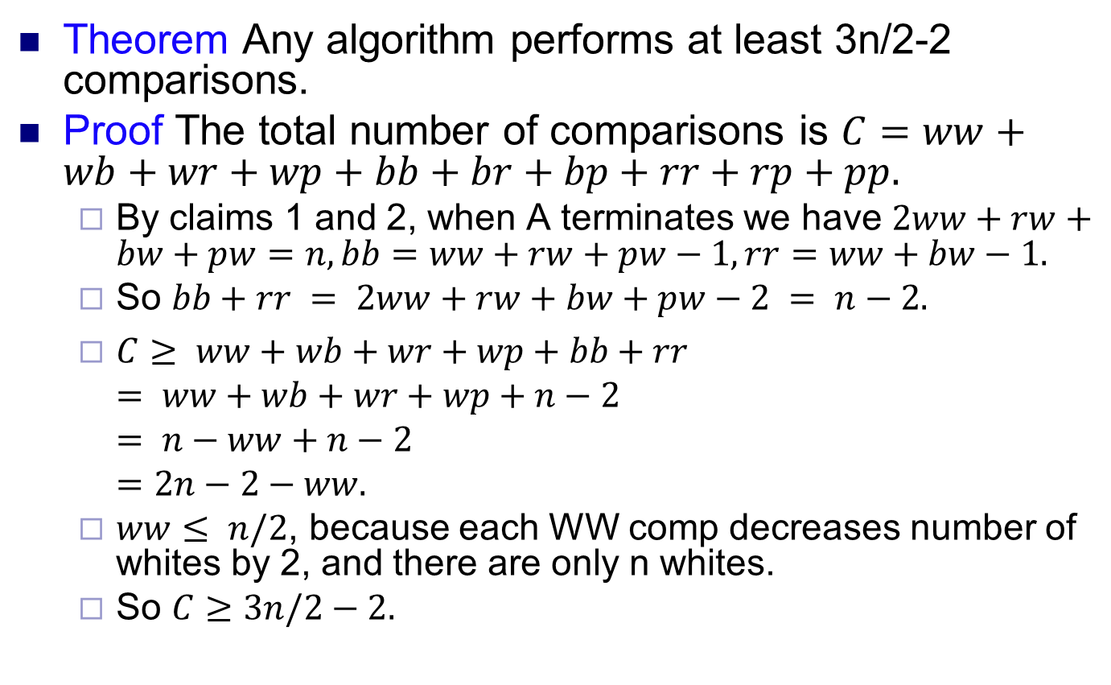
Finding the max and min
Theorem Any algorithm performs at least 3n/2-2 comparisons.
Proof The total number of comparisons is $C=ww+wb+wr+wp+bb+br+bp+rr+rp+pp.$
By claims 1 and 2, when A terminates we have $2ww+rw+bw+pw=n, bb=ww+rw+pw−1, rr=ww+bw−1.$
So $bb+rr = 2ww+rw+bw+pw−2 = n−2.$
$C≥ ww+wb+wr+wp+bb+rr$
$= ww+wb+wr+wp+n−2$
$= n−ww+n−2$
$=2n−2−ww.$
$ww≤ n/2$, because each WW comp decreases number of whites by 2, and there are only n whites.
So $C≥3n/2−2.$

Slide 21
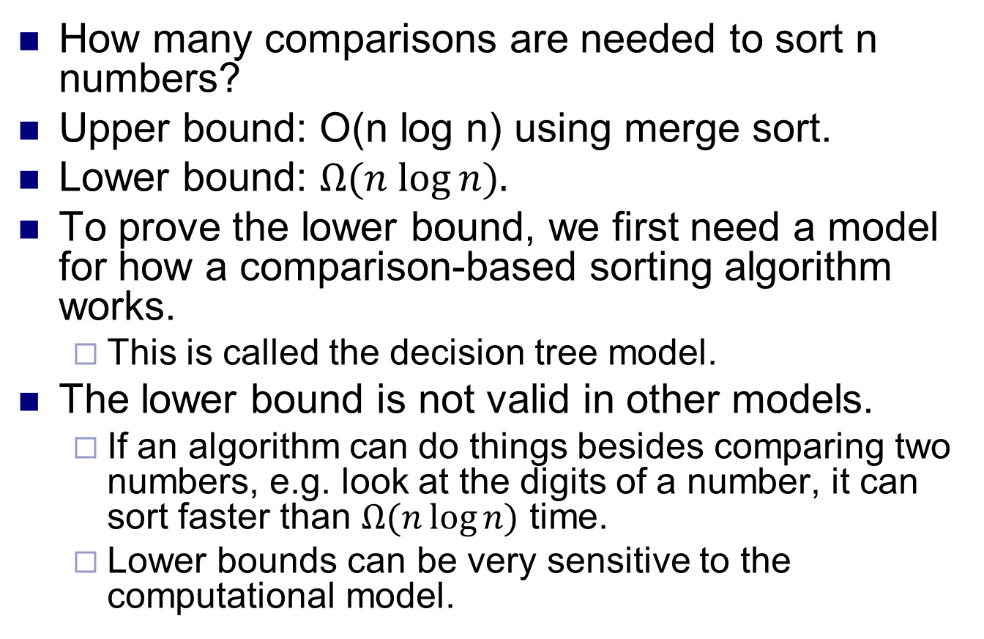
Sorting
How many comparisons are needed to sort n numbers?
Upper bound: O(n log n) using merge sort.
Lower bound: $Ω(n log⁡n).$
To prove the lower bound, we first need a model for how a comparison-based sorting algorithm works.
This is called the decision tree model.
The lower bound is not valid in other models.
If an algorithm can do things besides comparing two numbers, e.g. look at the digits of a number, it can sort faster than $Ω(n\log{n)}$ time.
Lower bounds can be very sensitive to the computational model.

Slide 22
Decision trees
In this model, in each step, algorithm can only compare a pair of numbers x, y.
Based on result of the comparison, it decides next pair of numbers to compare.
So an execution of the algorithm is a sequence of comparisons, each comparison determined by result of previous comparison.
When the algorithm terminates, it outputs a permutation representing the sorted order of the input.
The complexity of the algorithm is the most number of comparisons it does before terminating.

Slide 23
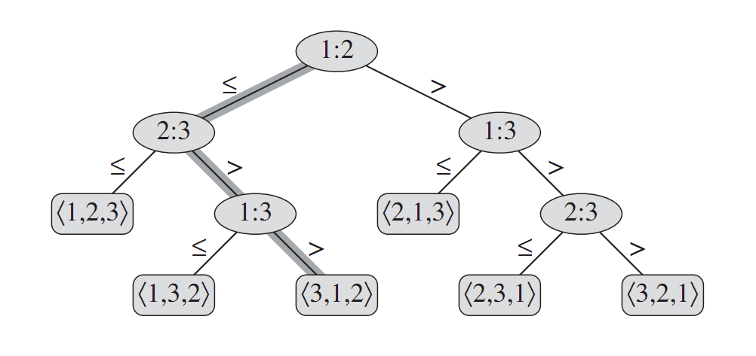
Decision trees
Model behavior of the algorithm by a binary tree.
Each internal node is a pair of number x,y to compare.
If x≤y, go to left child. If x>y, go to right child.
Each leaf represents an output, and is labeled with a permutation representing the sorted order of the inputs.
An execution is simply a path from root to a leaf.
At any node, the algorithm has obtained some info from the comparisons it’s done.
It uses this info to decide the next comparison to do.
Eventually, it obtains enough info to generate an output.
Complexity of algorithm is the length of the longest root-leaf path.

Slide 24
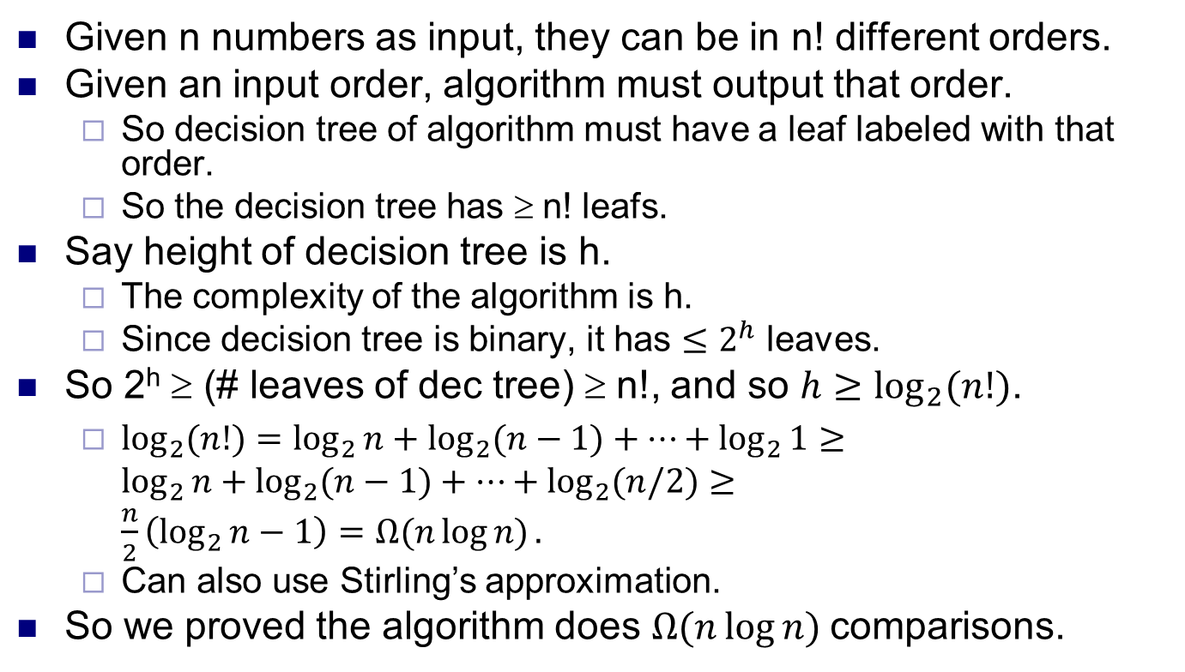
Lower bound for sorting
Given n numbers as input, they can be in n! different orders.
Given an input order, algorithm must output that order.
So decision tree of algorithm must have a leaf labeled with that order.
So the decision tree has ≥ n! leafs.
Say height of decision tree is h.
The complexity of the algorithm is h.
Since decision tree is binary, it has $≤2^{h}$ leaves.
So 2^{h} ≥ (# leaves of dec tree) ≥ n!, and so $h≥\log_{2}{(n!)}$.
$\log_{2}{(n!)}=\log_{2}{n+\log_{2}{(n−1)}+…+\log_{2}{1}≥}$
$\log_{2}{n+\log_{2}{(n−1)}+…+\log_{2}{(n/2})}≥$
$\frac{n}{2}\left(\log_{2}{n}−1\right)=Ω(n\log{n)}.$
Can also use Stirling’s approximation.
So we proved the algorithm does $Ω(n\log{n) }$comparisons.

